Slide 1
Illegal Parking Detector
By Team 9
2015410120 김용우 2017320122 김정규

Slide 2
CONTENTS
PART 1. OUTLINE
- Background
- Goal of the Project
PART 2. Description of IPD
- Arduino Mega2560
- HC-SR04P
- ESP-01
- Source Code
PART 3. Testing IPD

Slide 3
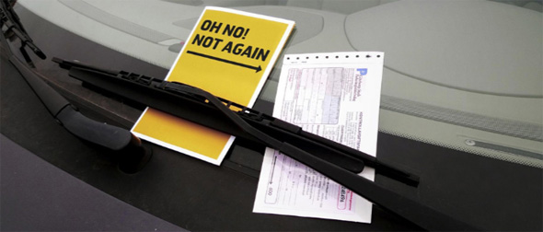
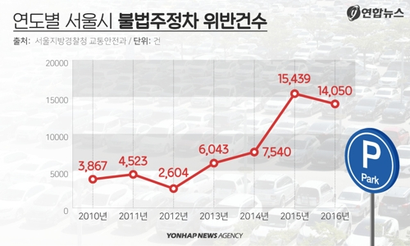
PART 1. OUTLINE
Background
The Rate of Illegal Parking is Continuously Getting Higher

Slide 4


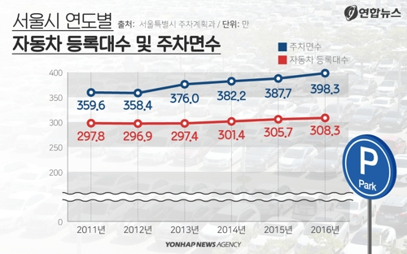

PART 1. OUTLINE
Goal of the Project
01
The amount of vehicles that registered is rising.
02
Hence, the rate of illegal parking rises too.
03
We thought it is inefficient to use human resource for this.
04
It is necessary to make the crack-down process automatic.
05
So we made ‘IPD’ to approach this goal

Slide 5

PART 2. Description of IPD
What is IPD?
IPD
(Illegal Parking Detector)
!
Illegal Place
IPD
Vehicle
manager

Slide 6
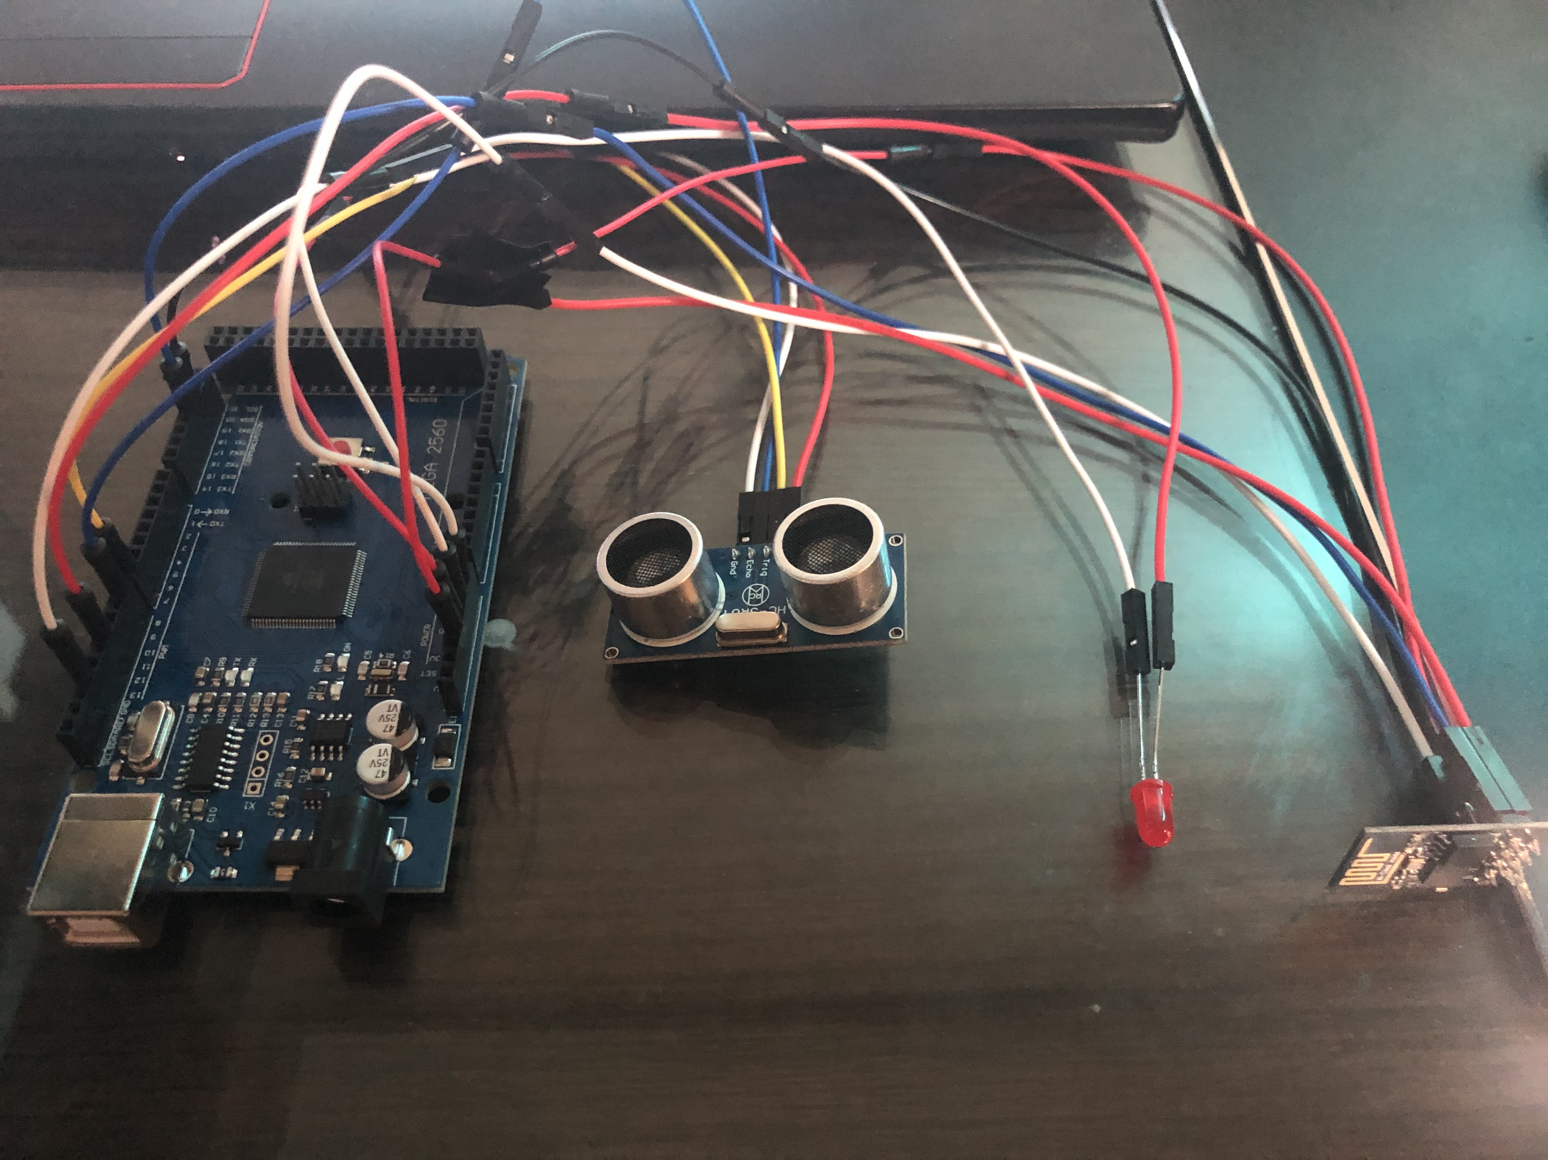
PART 2. Description of IPD
What is IPD?
HC-SR04P
BL-B5134
ESP-01
Arduino Mega2560

Slide 7
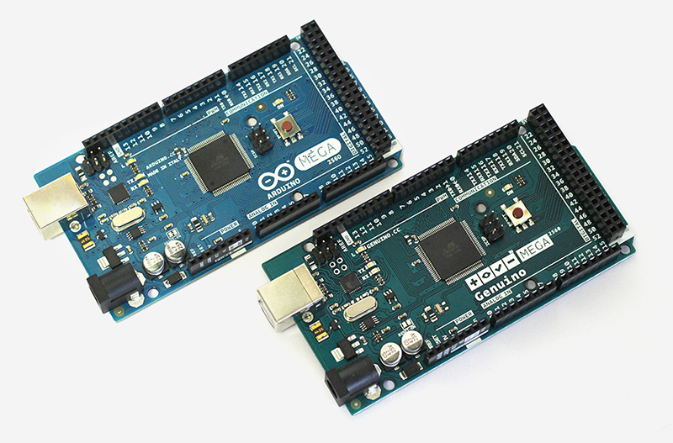
PART 2. Description of IPD
Arduino Mega 2560
Operating Voltage : 5V
Input Voltage : 6-20V
54 Digital I/O pins
16 Analog write pins
I/O pin Voltage : 20mA
3.3V pin Voltage : 50mA
256KB Flash Memory
SRAM : 8KB
EEPROM : 4KB
Clock Speed ; 160MHz
Built-in LED : 13th pin
This model that can provide more memory and I/O pins than UNO. So this is suitable for complex projects that is impossible for UNO

Slide 8
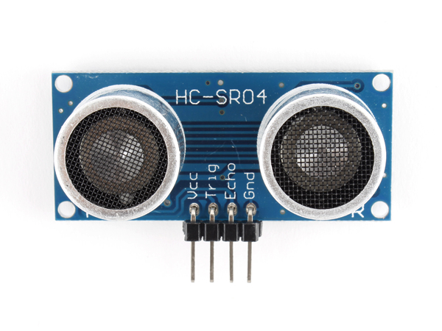
PART 2. Description of IPD
HC-SR04P
Power Supply : 5V DC
Quiescent Current : <2mA
Effectual Angle : <15°
Ranging Distance : 2cm-500cm
Resolution : 0.3cm
This module uses ultrasonic waves to measure the distance of objects in front of the sensor.

Slide 9
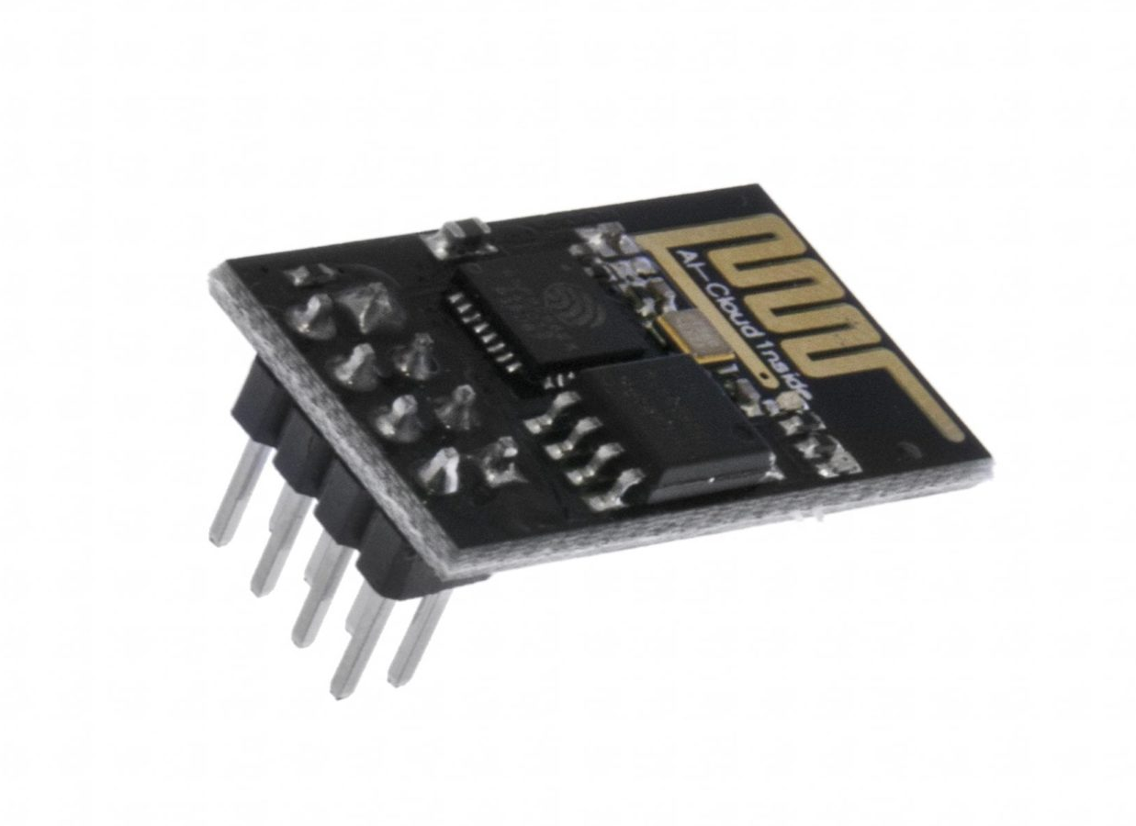
PART 2. Description of IPD
ESP-01
8Mb Flash Memory
32-bit CPU running 80MHz
3.3V supply
PCB-trance antenna
2x4 dual-in-line pinout
The ESP-01 is a Wi-Fi module that allows microcontrollers access to a Wi-Fi network. This module is a self-contained SOC (System On a Chip) that doesn’t necessarily need a microcontroller to manipulate inputs and outputs as you would normally do with an Arduino.

Slide 10
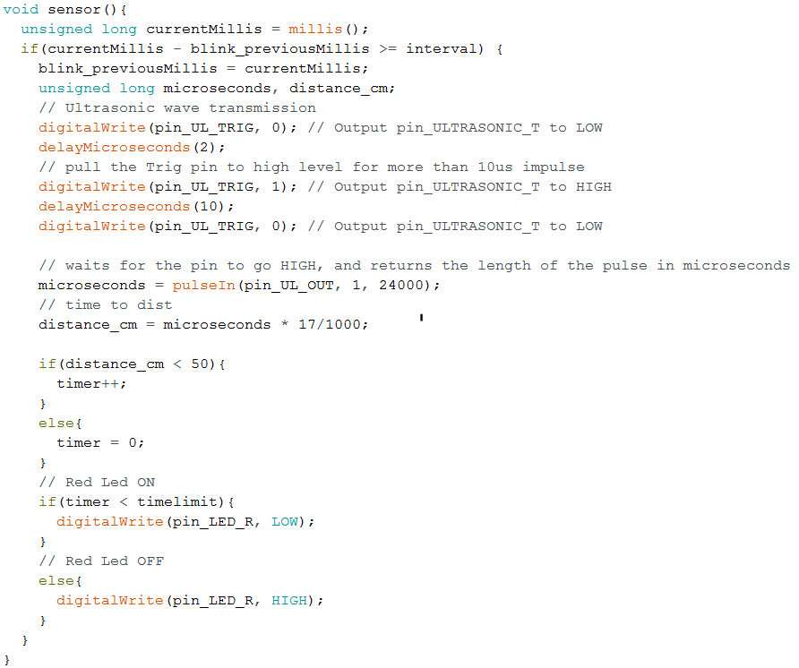
PART 2. Description of IPD
Source Code
This source code is about the module, HC-SR04P. Trough this code, the module calculates the distance between the sensor and the object which is in front of the sensor.
There is also ‘timer’ that counts seconds which means that how long the object was detected by sensor.
We use this timer to distinguish if there is a car parked in front of the sensor, or just some objects that just passing by.

Slide 11
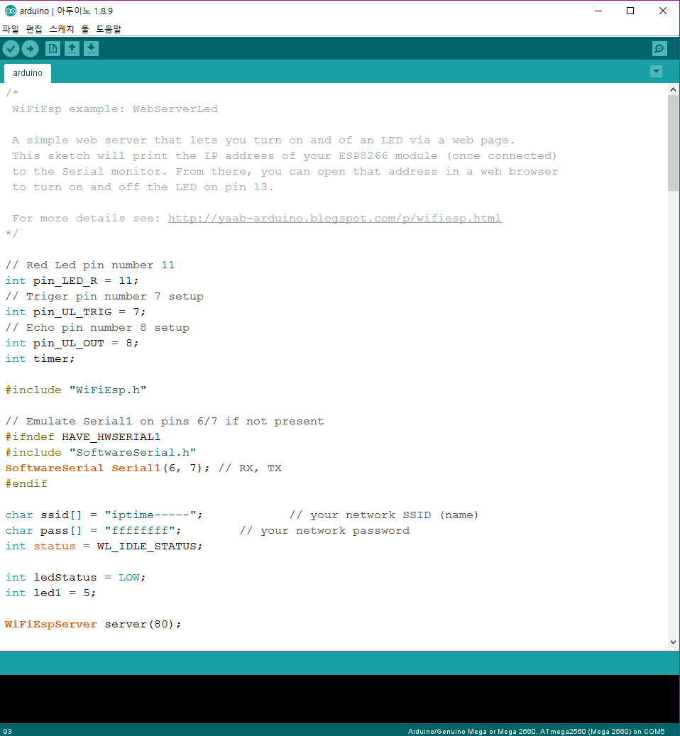
PART 3. Testing IPD
Test

Slide 12
THANK YOU

